Slide 1
Operation: Social Engineering Heist
By Hondo, Christian, Adam, and Blake

Slide 2
Mission Objective
Inform people about social engineering
Conduct a mock heist of project/network information at RowdyHacks
Bring attention to the dangers of social engineering
Demonstrate data leakage through complacency
Conduct research on the potential vulnerability of students to SE

Slide 3

Description
Our team conducted a social engineering exercise at RowdyHacks to educate users on what Social Engineering (SE) is and to survey responses to establish a baseline for how vulnerable students could be to SE. We established two roles to conduct information and network reconnaissance and gather all available information.
Additionally, our exercise was a valid attempt to conduct a "heist" of information, showcasing the sheer amount of data one can get through lower effort.
We saw success at completing this objective.

Slide 4
Why it matters?
Social Engineering is on the rise, and an increasing number and type of people are being targeted and exploited.
To counter social engineering, you must inform and educate the public about what social engineering is, the various forms that it comes in and the harm that it can cause.
We also wanted to show that SE has a wider impact than just psychological manipulation by conducting physical reconnaissance alongside our social engineering.

Slide 5
The chosen ROles
Both roles were responsible for their own conduct for a successful heist of the data they seeked. Objectives were set for each role to ensure smoothness.
The Engineer
The sniffer
For this role, the person would use social engineering and pretexting to achieve the following objectives:
Learn any information about people’s projects by asking questions while maintaining the cover of construction workers.
Establish a sense of trust, or connection.
Buy as much time possible, so that the sniffer can collect as much data that they can.
Analyze initial reactions and debrief groups after exercise is over.
Demonstrate the psychological impacts of social engineering.
For this role, the person would use network monitoring tools to achieve the following objectives:
Identify any devices transmitting on wireless connections.
Capture all data being transmitted in the general area.
Debrief and report on all data collected during analysis phase.
Demonstrate the physical/logical impacts of social engineering.

Slide 6
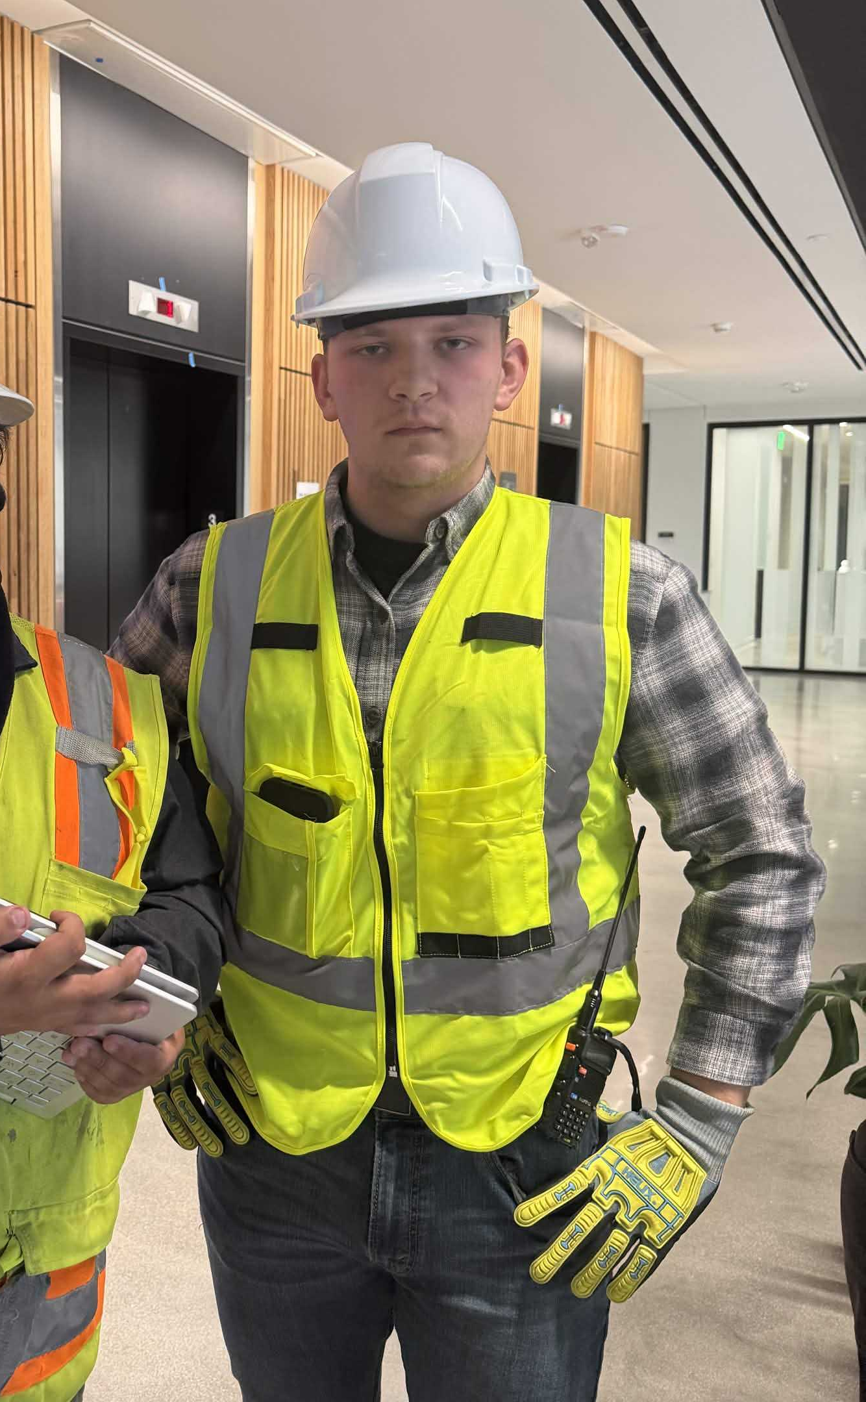

The Engineer
To ensure the sniffer could carry out its duties, the impersonator buys enough time by using social engineering tactics to pry out any information and keep eyes off the sniffer.
Impersonators kept suspicion low by using authentic equipment, speaking in vague but technical terms, and using environmental context to establish a readily believable story for further psychological pivoting.
Additionally, audio was recorded both before and after the exercise reveal to debrief on results and establish a burden of proof for SE attempts and group responses.

Slide 7
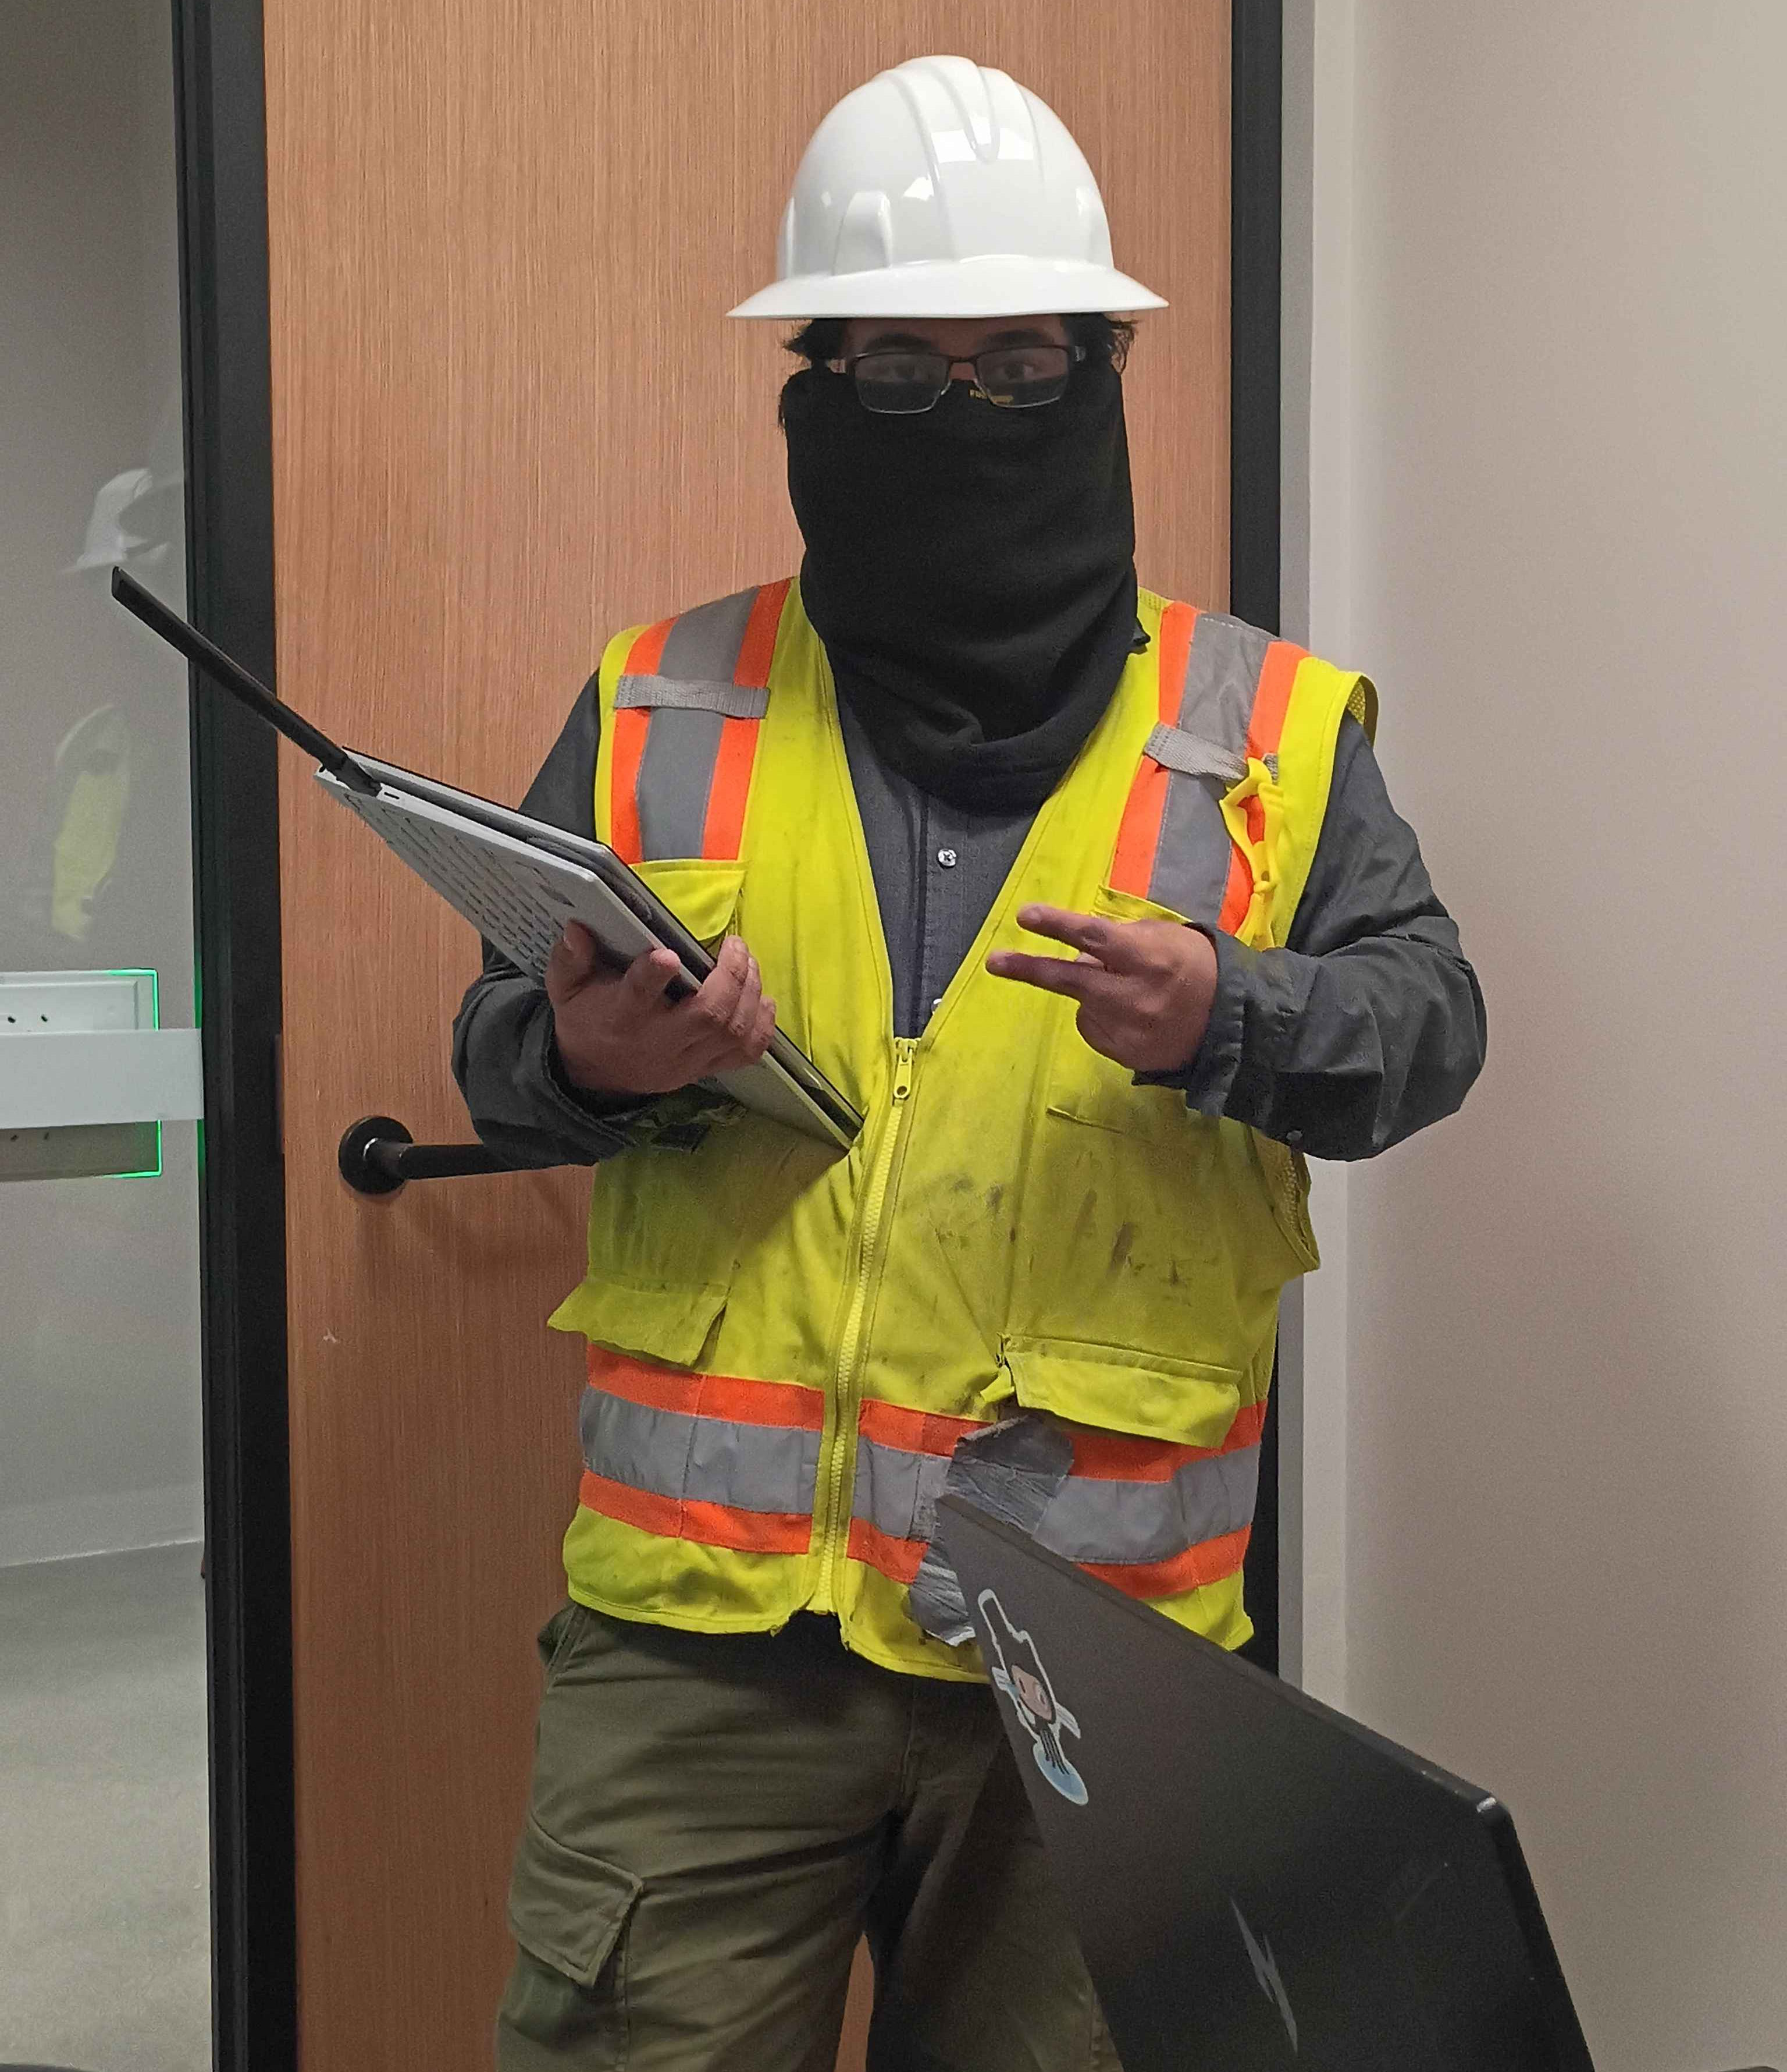

Packet Sniffer
The engineer assigned to packet sniffing utilized a variety of tools to capture, store, and analyze data. As the Engineer stalled for data, the sniffer would conduct the capture.
Wireshark and Kismet were used for packet capture.
NetworkMiner identified patterns and communication in PCAPS.
Monitor Mode Antenna was used to retrieve packets without direct connection.
Authentic gear hid all notable features for harder identification of physical threat within social engineering.

Slide 8
Results
After surveying 19 groups, we analyzed the exercise debriefs and found an average suspicion-to-belief ratio of 80:20.
Of the groups that grew suspicious, fewer took action. Those actions included:
1 active report to organizers on suspicious social engineering activity.
1 attempt at verification of employment of the engineers through their employee ID.
1 attempt to hamper sniffer activity by enabling airplane mode.
Only 7 groups displayed active resistance and hesitation to social engineering.
Despite these actions, many more were willing to give up information that a real social engineer would find useful, even within a competition environment.
17 of the 19 groups disclosed their active network connection method, allowing tailored sniffing on a specific bandwidth to occur.
Despite suspicion, many played along, which can be dangerous, since the sniffer could still capture their data without having them directly giving up their information.
Lack of action from groups allowed the social engineering to spread to other groups without competitors warning each other of it occurring.

Slide 9
Feedback
Why people believed us
Why THE Pretext failed
Story Plausibility
Documented Wi-Fi drops had occurred and, our inclusion of those details in our pretext was plausible to people. The surveyors weaponized a real, ongoing convenience
Appearance
The appearance of construction workers didn’t initially raise suspicion, as they did not match the expected look of a social engineer.
Prop Justification
Although the antenna was used for a different purpose, the sight of it related to the story that we provided to people, convincing them that we were actual construction workers.
Visual/Wardrobe Anomalies
A lack of gear paired with new-looking equipment, as well as a dedicated cybersecurity laptop, aroused suspicion in those who took a closer look. They understood how the average construction worker should look, which did not match their view.
Logical Anomalies
Although the pretext established itself well with context, the logical conclusion people point to is that construction workers do not deal with IT infrastructure.
Personal Recognition
Several group members recognized some members of our team, which immediately blew their cover, and the roles were forced to rotate.

Slide 10
Conclusion
Although we had a high suspicion rate, we would still largely consider our exercise a success for social engineering for several reasons:
Despite claims of suspicion, many did not conduct any action against us, having expected others to do so or not taking the threat as serious, acting as a bystander instead.
Others, understandingly, assumed it was organized by the competition staff, and did not take the threat as serious as they would have in another context.
Students gave mismatching info during their debrief, hinting that they may have potentially been lying about their suspicion, compared to how much information they, or their team provided.

Slide 11



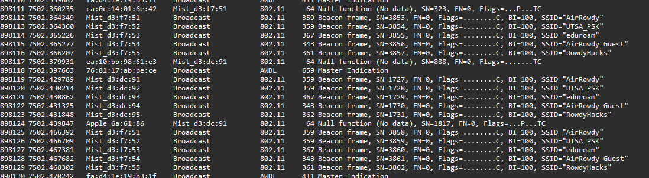


Evidence
Provided information about what devices they were using
Was suspicious and didn’t give information but never informed anyone
Turned on Airplane mode
Above is a portion of the network traffic obtained, which includes broadcasts from the local access points and devices. All actual student PII that was captured has been removed for the scope of this competition.
Did not suspect social engineering
Provided Details about their project
The following videos include the results from both the recorded answer section and the feedback section. The checkmark represent the answers that we were looking for and the x mark means that the answer they provided was dangerous for their security and was a risk. The question mark is a mixture of both.

